Slide 1



UNIVERSITY OF THE AEGEAN
Department of Information and Communication Systems Engineering
GrowBuddy
Mentorship that moves you forward
VASILEIOS KAKAGIANNIS | VASILEIOS KARADIMAS | GEORGIOS KOKKINAKIS
ΑΜ:3212024071 | ΑΜ: 3212022068 | ΑΜ: 3212024093

Slide 2
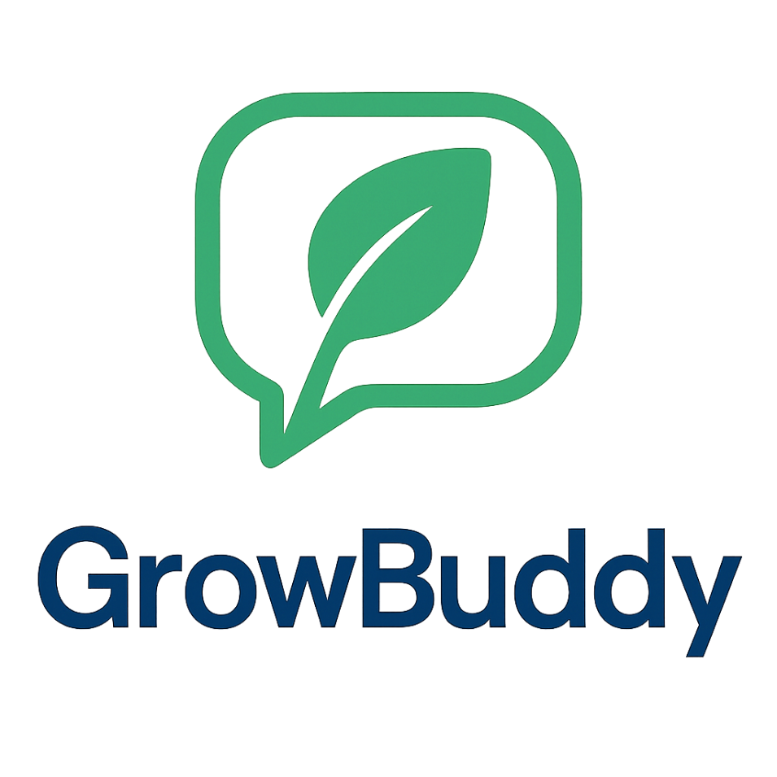
The Idea
• What we do: GrowBuddy is an AI-driven mentor that helps startups and SMEs design and execute a growth plan.
• Vision: Make high-quality mentoring and AI adoption accessible, practical, and scalable.
• Offering: Personalized roadmap + hands-on execution support + progress tracking (via platform).
• Customers: Early-stage startups and SMEs that lack in-house AI and business expertise.
• Revenue model: SaaS subscriptions (tiers) + add-on mentoring/implementation hours.
• Innovation: Hybrid approach (AI + human expertise) with an iterative improvement loop (plan → act → measure → improve).

Slide 3
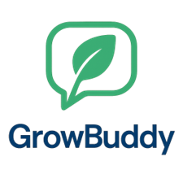
The Need
UNIVERSITY OF THE AEGEAN
Problem: Startups and SMEs struggle to integrate AI into real business processes (beyond high-level theory).
Who has this need: Early-stage startups and SMEs—especially teams without in-house AI expertise and founders already experimenting with AI but lacking clear strategy and training.
Why it matters: Without structured guidance, AI adoption becomes slow and fragmented, increasing the risk of wasted time, wrong tool choices, and compliance/data workflow issues.

Slide 4
The Need
UNIVERSITY OF THE AEGEAN
How it is currently solved: Trial-and-error with tools, generic online courses, ad-hoc consultants, and one-off mentoring sessions.
Why current solutions are insufficient: They are often not tailored to the company’s context, lack execution/accountability, are expensive, and don’t provide continuous support as tools evolve.
Evidence / context (EU): The EU has 32.3M enterprises, and 99% are micro & small businesses, meaning a very large base of firms that typically need external guidance rather than in-house specialist teams.

Slide 5
Why Existing Solutions Are Not Enough
UNIVERSITY OF THE AEGEAN
Most startups and SMEs cannot hire in-house AI talent due to high cost and limited availability.
External consultants can help, but they are often expensive and project-based (limited continuity).
Generic courses and online resources are not tailored to a company’s context and rarely translate into execution.
Traditional mentoring depends on human availability and cannot provide continuous, 24/7 support.
As AI tools evolve rapidly, companies are left without ongoing guidance, accountability, and a sustainable adoption path.

Slide 6
The Solution
•Personalized business mentoring tailored to each startup/SME’s needs.
•Hands-on, practical guidance focused on implementation (not just theory).
•Custom growth strategies & roadmaps aligned with the client’s goals and processes.
•Ongoing support & iteration to ensure continuous improvement.
•Affordable expert support without the need for expensive in-house hires.
•24/7 availability for guidance, resources, and decision support.
UNIVERSITY OF THE AEGEAN

Slide 7
Why GrowBuddy Stands Out
Fully tailored mentoring (not “one-size-fits-all”).
Execution-first approach with clear next steps and accountability.
Fast, measurable improvements in decision-making and operational processes.
Hybrid support: AI guidance combined with human expertise when needed.
Scalable model that fits both early-stage startups and growing SMEs.
Unique Selling Proposition (USP)
UNIVERSITY OF THE AEGEAN

Slide 8
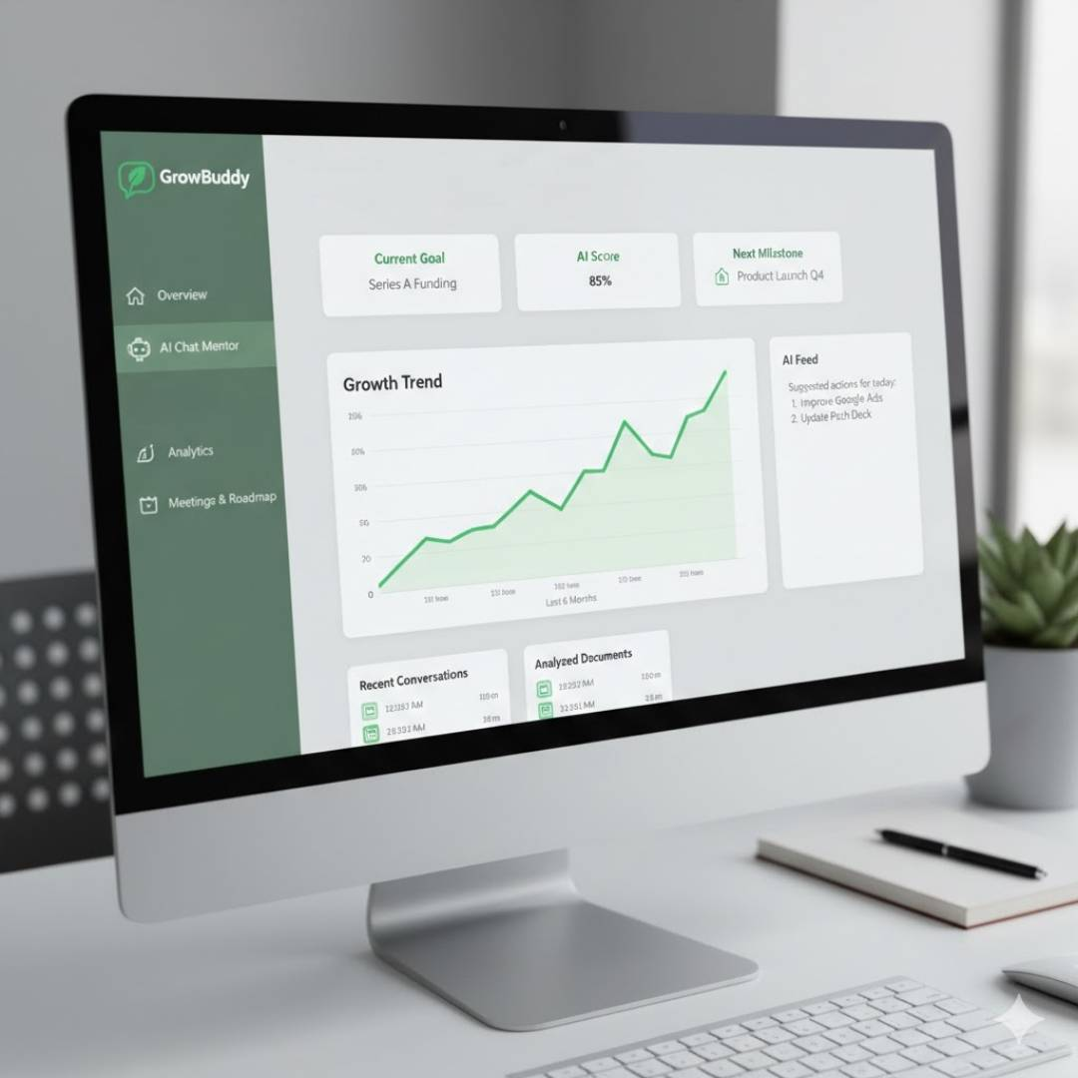
This is a mock-up of our website:
UNIVERSITY OF THE AEGEAN

Slide 9
The Market (TAM / SAM / SOM)
UNIVERSITY OF THE AEGEAN
TAM (Global): Corporate e-learning $104.32B (2024) + Business coaching $ 6.25B (2024) → TAM = $110B (AI mentoring + online training).
SAM (EU): 32.3M EU enterprises, 99% SMEs → target 5% digitally oriented SMEs = 1.6M potential clients.
SAM value: 1.6M potential clients × €150/year = €240M/year.
SOM (Realistic): 3% of SAM = 48,000 customers.
SOM revenue (at €150/year): €7.2M ARR.

Slide 10
Target Segments & Data Sources
UNIVERSITY OF THE AEGEAN
Key Market Segments
Early-stage startups in Europe needing structured guidance to adopt AI in operations.
SMEs in services, tech, and knowledge-intensive industries that lack in-house AI expertise.
Founders and small teams already experimenting with AI tools but without a clear strategy or training.
Data Sources (for market sizing)
Global corporate e-learning market size: Grand View Research — Corporate E-Learning Market Report 2024.
Global coaching industry revenue: International Coaching Federation (ICF) / PwC — Global Coaching Study 2024–2025 (referenced via Entrepreneurs HQ in your notes).
Number of SMEs in the EU: Eurostat / European Commission — “Micro & small businesses make up 99% of enterprises in the EU” (32.3M enterprises, 2022).

Slide 11
Competition & Differentiation
UNIVERSITY OF THE AEGEAN
Main competitors:
CoachHub — Digital coaching platform with AI-based matching and an AI coach (AIMY), focused on scalable coaching for organizations.
BetterUp (BetterUp Grow™) — AI coaching that blends technology with human coaching, designed for enterprise-scale development and measurable performance.
GrowthMentor — Mentorship subscription with unlimited 1:1 mentor sessions, AI-powered matching, and AI summaries of calls; strongly founder/startup-oriented.Differentiation
GrowBuddy focuses on startup/SME business execution (roadmap + accountability) with hybrid AI + human support, not just coaching sessions or mentor calls.

Slide 12
UNIVERSITY OF THE AEGEAN
Competition table
USP Feature (your wording) | CoachHub | BetterUp | GrowthMentor | GrowBuddy
Fully tailored mentoring (not “one-size-fits-all”). | Fully | Fully | Partially | Fully
Execution-first approach with clear next steps and accountability. | Partially | Partially | Partially | Fully
Fast, measurable improvements in decision-making and operational processes. | Partially | Partially | Partially | Fully
Hybrid support: AI guidance combined with human expertise when needed. | Fully | Fully | No | Fully
Scalable model that fits both early-stage startups and growing SMEs | No | No | Fully | Fully

Slide 13
Go to Market Strategy
UNIVERSITY OF THE AEGEAN
Customer approach: Target founders/SME decision-makers via LinkedIn outreach, offer a free discovery call, then convert with a 2–4 week pilot and case-study based upsell to annual subscription.
Core channels: LinkedIn (primary), SEO content + landing page, email newsletter, partnerships (incubators/accelerators/coworking), startup events & workshops.
Paid acquisition budget (Year 1): €10,000/year (aligned with Cost Structure):
Google Search Ads: €5,000/year
Instagram/Facebook Ads: €5,000/year
Organic (non-ad) channels: LinkedIn outreach (content + networking), SEO articles, newsletter content, partner referrals, workshops (time-driven, not paid media).

Slide 14
Go to Market Strategy
UNIVERSITY OF THE AEGEAN
Key partners needed: Incubators/accelerators, innovation hubs, SME associations, coworking spaces.
How we get partners: Run free “AI adoption” workshops/webinars for their community, offer discounted pilots for members, exchange visibility + access + testimonials.
Conversion flow (simple): Outreach → Discovery call → Pilot (2–4 weeks) → Subscription → Optional mentor add-on.
Legal / obstacles: GDPR-compliant data handling (privacy-by-design), clear consent and data-retention policy.
Human oversight: Human-in-the-loop for high-impact recommendations (e.g., compliance-related or sensitive business decisions).

Slide 15
Technology / Intellectual Property
UNIVERSITY OF THE AEGEAN
Our IP: Proprietary mentoring framework (structured sessions, prompt templates, playbooks) for startup/SME growth and AI adoption.
Tech / architecture: Web platform (React + API + SQL) using LLM APIs, with our business-logic layer (profiling, orchestration, guardrails, logging).
Algorithms / data:
Matching: company profile → tools + learning paths
Progress scoring: activity + tasks → milestones + next actions
Knowledge base: curated templates/checklists, improved over time
Barriers to entry: Specialized methodology + growing data/insights + integrated workflow/partnerships that are hard to replicate quickly.

Slide 16
Pricing & Revenue
UNIVERSITY OF THE AEGEAN
Model: B2B team account (SMEs/startups).
Plans: Freemium (limited) → Premium €150/year/company.
Add-on: Human Mentor Support +€50/year (20% uptake).
COGS : Premium €10/company/year = (€5 product + €5 service) Add-on €15/add-on/year (service).
Year-1 (end-of-year ARR): 120 companies → €19,200 run-rate. (XLS uses B2 average customers for yearly revenue recognition).
Paid ads: Google Search + Instagram/Facebook.

Slide 17
Cost Structure (Years 1–4)
UNIVERSITY OF THE AEGEAN
Headcount (FTE): Y1: 6 | Y2: 8 | Y3: 9 | Y4: 12
Salary assumptions: Founders €20k/year each; other hires €30k/year each
Costs by year (€):
Personnel: 150,000 | 210,000 | 240,000 | 330,000
Operating / G&A: 16,600 | 20,000 | 23,000 | 35,000 (includes baseline cloud & tools; minimum cloud+AI baseline €3,600/year)
Marketing: 10,000 | 20,000 | 30,000 | 80,000 (paid ads focus: Google Search + Instagram/Facebook)
Other: 8,000 | 12,000 | 15,000 | 20,000 (legal/accounting, software licences, external experts)
Total Fixed Costs: 184,600 | 262,000 | 308,000 | 465,000

Slide 18
Roadmap (Next 24 Months)
UNIVERSITY OF THE AEGEAN
Key milestones:
0–12 months: Finalize MVP, run pilots with 5–10 startups, secure 2–3 partnerships with incubators/accelerators.
12–24 months: Full product launch, reach 100+ active customers, and achieve stable recurring revenue.
Product / service expansion:
Add new mentoring tracks (for founders, teams, and specific business functions).
Introduce advanced analytics, more AI tool integrations, and richer self-serve content.
Market expansion:
Start with Greek and EU startups/SMEs (English-first positioning).
Gradually expand to the wider EU SME market and other English-speaking countries.
Key risks:
Slow adoption from SMEs or strong competition from larger training/coaching platforms.
Dependence on third-party AI providers and potential changes in AI regulations (EU AI rules).

Slide 19

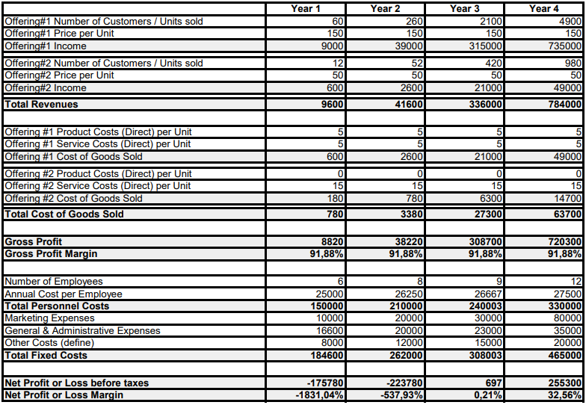
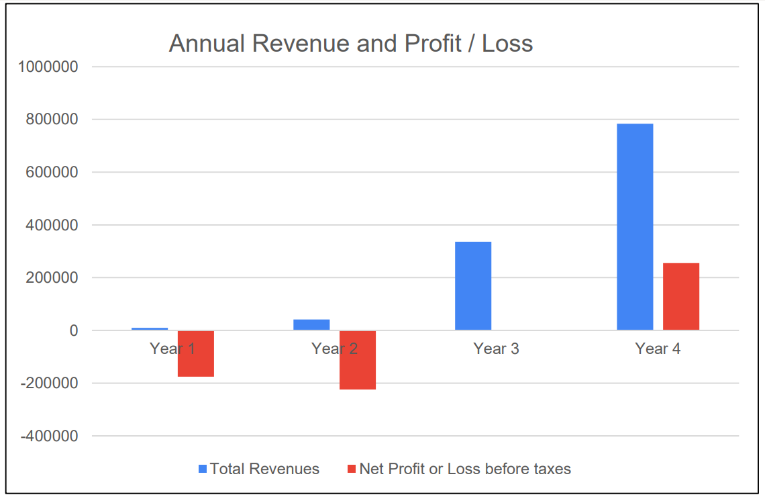
GrowBuddy
Financials (XLS)
CONTENT FORMAT
CONTENT DISTRIBUTION
MONTHLY CLIENT REPORT
PAGE 3

Slide 20
Financials (XLS)
UNIVERSITY OF THE AEGEAN
Method (B2): Annual revenues are calculated using average customers per year:
AVG customers = (Start-of-year customers + End-of-year customers) / 2.
Offerings used in XLS:
Offering #1: Premium subscription €150/year per company (team account).
Offering #2: Human Mentor Support add-on +€50/year, with 20% uptake.
COGS (Direct costs per unit) assumptions:
Premium: €5 Product + €5 Service = €10/company/year (AI/API + incremental cloud usage).
Add-on: €0 Product + €15 Service = €15/add-on/year (light human support / ops).
Fixed costs (from Slide 10): Personnel, operating, marketing, other costs follow the cost structure section.

Slide 21
The Team
UNIVERSITY OF THE AEGEAN
Founders (roles):
Vasileios Kakagiannis — CEO/CPO: Vision, partnerships, GTM
Giorgios Kokkinakis —CFO: Financial planning & budgeting, pricing/unit economics, and Financials (XLS) forecasts.
Vasileios Karadimas — CTO/AI Lead: Mentoring framework, AI workflows, delivery quality
Key hires: Full-stack Dev AI/ML Engineer, Marketing & Sales (optional: UX)
Why we win: Complementary skills + execution speed + tailored methodology (pre-built playbooks; no user “training” needed).

Slide 22
UNIVERSITY OF THE AEGEAN
THANK YOU
Have questions about our idea?
IF YOU HAVE, CONTACT WITH US:

